Slide 1
OPD Appointment System
ARIA TELECOM SOLUTIONS PVT. LTD.
Web: www.ariatelecom.net

Slide 2
Company Profile
Since 2003 Aria Telecom is working hard towards satisfaction of our clients, with our team efforts & our client’s support we became India’s No 1 IVR, Voice Logger & in many more customized telecom solutions company.
Aria has team of more than 20 qualified engineers for R&D & support. Aria also has most experienced team of marketing managers with technical background to understand client requirements. Aria has presence in most of the metro cities in India. Aria also has clients outside India like Nepal, Bhutan, Africa countries, Arab countries.
Aria Product Profile:
1. Parth – Unified Communication System, Can be used for following applications: IP PBX, IVRS, Call Center Applications, Predictive dialer, OBD IVRS, Conference Bridge, ISDN PRI Logger, Intercom for housing society system , CRM, Live Chat, ACD
2. TVRS- Telephone Voice Recording System
3. Embedded Voice Logger- Non PC Based Voice Logger
4. Aria Call Center Noise Cancelling Headsets: High quality call center Noise Canceling Headset with USB, RJ9, 2.5mm, 3.5mm, Dial pad

Slide 3
OPD Appointment system
.
OPD Appointment system is an online patient appointment booking system for doctor using IVRS, Website/ Portal and Mobile app.
OPD appointment system is available on the internet, allows patients to book an appointment from the comfort of their homes, using their computer, laptop or mobile, and at any time. Patient can book appointment via IVR, website portal and Mobile app

Slide 4
KEY FUNCTIONALITIES
Book Appointment
Appointment details sent to patient’s mobile number with date,time, appointment number etc.
Doctor/Patient login
Web based , Mobile App , IVRS Appointment booking system
Book any time and any where

Slide 5
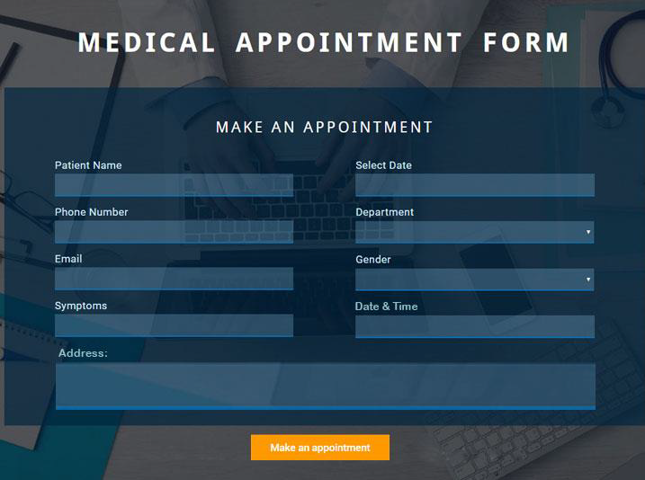
Web based APPOINTMENT
Patient will go to the website/portal to book appointment through online form. Patient will fill up all the details accordingly. After submitting the form, Confirmation Message will be send to patient’s mobile number.
A Day before appointment: A reminder message will be sent to patient mobile number.

Slide 6
Appointment Booking through Mobile App
Patient can book appointment via mobile app. whenever appointment is booked, a confirmation message will be sent to patient mobile number.
A day before appointment, a reminder will be sent to patient mobile number.
Advanced features:-
Signup with basic details
Login using Email and password
Forget password
Create and edit patient profile.
Map integration for the location purpose
Acknowledgment to patient for appointment booking, cancellation or delay.

Slide 7
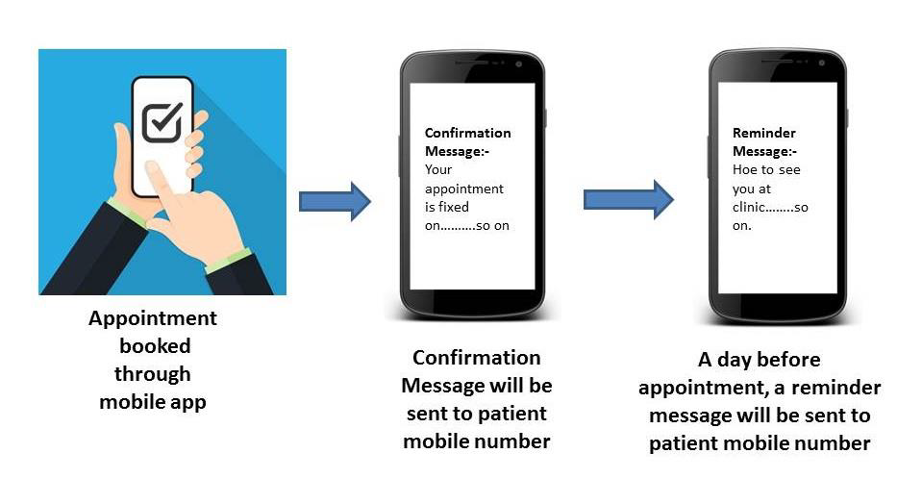
Appointment Book through Mobile App

Slide 8
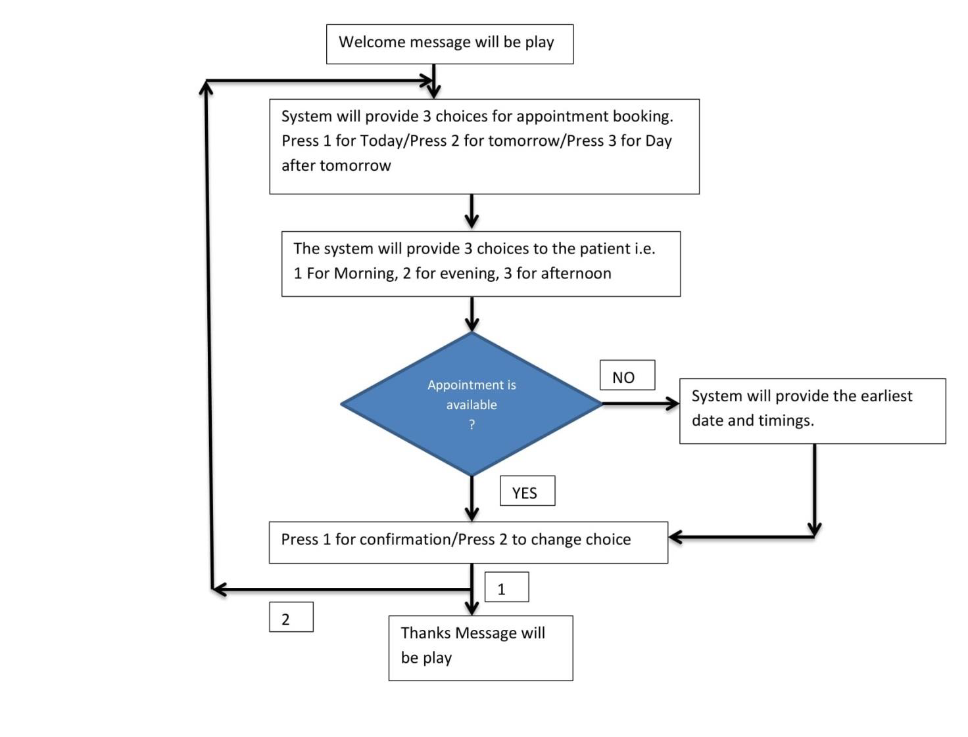
IVR Appointment Booking

Slide 9
IVR Call Flow Description
We have allotted Unique Number to doctors. Patient will call on one of those numbers welcome message will be play with doctor’s name. System will offer a choice prior up to 3 days booking (Today, Tomorrow and Day after tomorrow) and also offer a time slot (Morning, Afternoon & Evening) as patient will give input by DTMF,IVR will pass the basic details of booking Patient phone no., Date and Time slot to system via API.
System will check the availability based on the choices received and provide the appointment date and available time back to IVR via API.
If the appointment is available then the IVR will make a call to patient and ask for the confirmation for appointment and it will provide two option first one is for confirmation or second one is to change the choice as per patient input it will precede accordingly.
If the appointment is not available based on the preference provided by patient, the system will pass on the next earliest available date and time to the IVR system which IVR will play back to patient that time patient will have two options either he can confirm the appointment provided by system or he can choose slot again as per his choice.
Once the Patient will give confirmation, Thanks message will be play and call will be drop.

Slide 10
Front Desk Appointment Booking
CRM Solution
There will always be some requirement for the staff to maintain appointment centrally, easily change, shift the appointment and to book the appointment for walking patients.
We will provide a web based CRM solution to the staff. All the staff can access our web based CRM tool from anywhere, anytime. You can view, make or cancel appointments and can integrate any other features as per requirements.
Admin features
The main features of admin module are given below:-
Manage appointments
Manage Patient details
Manage doctors details
View Appointments statistics
Rating Details

Slide 11
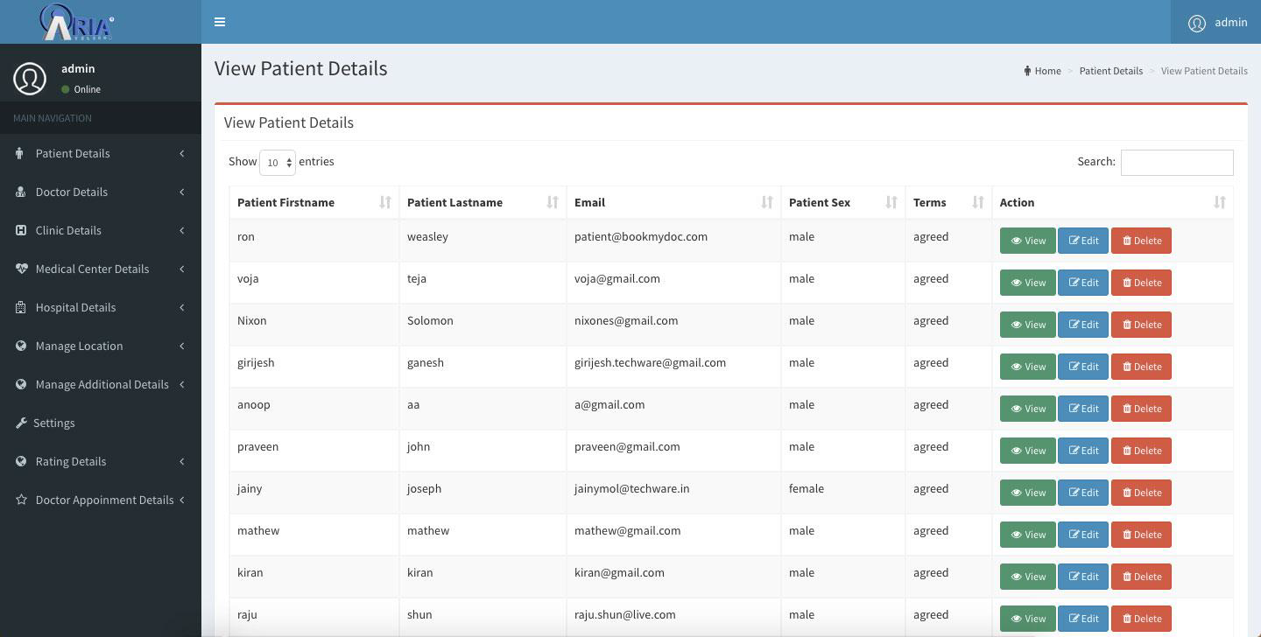
Admin Features

Slide 12
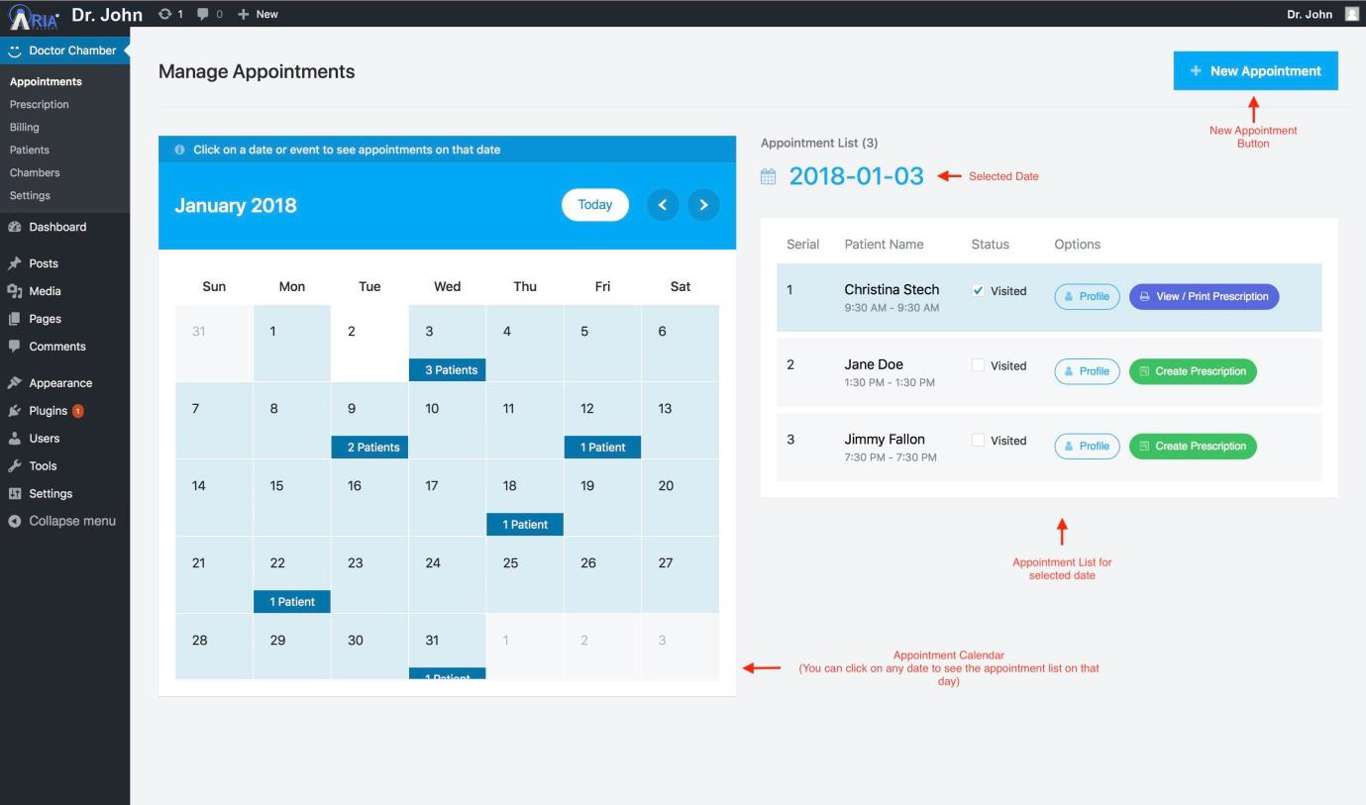
Doctor/Staff (Agent) features:-
Easy and User friendly Sign Up, Sign In
Account Password Recovery
View Appointments
Manage appointments
Make new appointments
Can updates edit profiles and can add images.

Slide 13
Patient Feedback System through IVRS
Outbound IVR (OBD IVR):-
Calls are sent out to the contact numbers from the database provided by the customer/patient. An outbound call is triggered and a predefined IVR call flow is played to the user/patient.
Based on the input entered by the user/patient, the smart IVR system will take over or the call gets disconnected.
The responses entered by the users can be sent in real-time to an end-point specified the company.
Separate MIS Reports will be provided for the same.

Slide 14
Feedback IVR

Slide 15
BENEFITS
Brings Healthcare Experts to Remote Areas
Saves Time and Travel Costs for Patients
See More Patients in Less Time
Closest to an in person-consult, real time interaction
Less pressure staff
Control on visitor patients
24*7 hours services available

